Slide 1
Global Health Management: Rio de Janiero, Brazil 2014

Slide 2
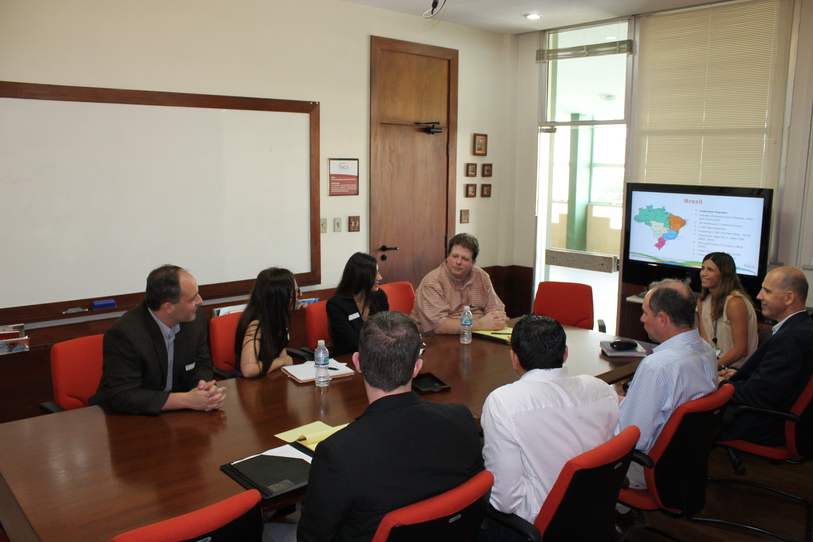
INCA: Transplant Center & Cancer Institute
Presentation by staff

Slide 3
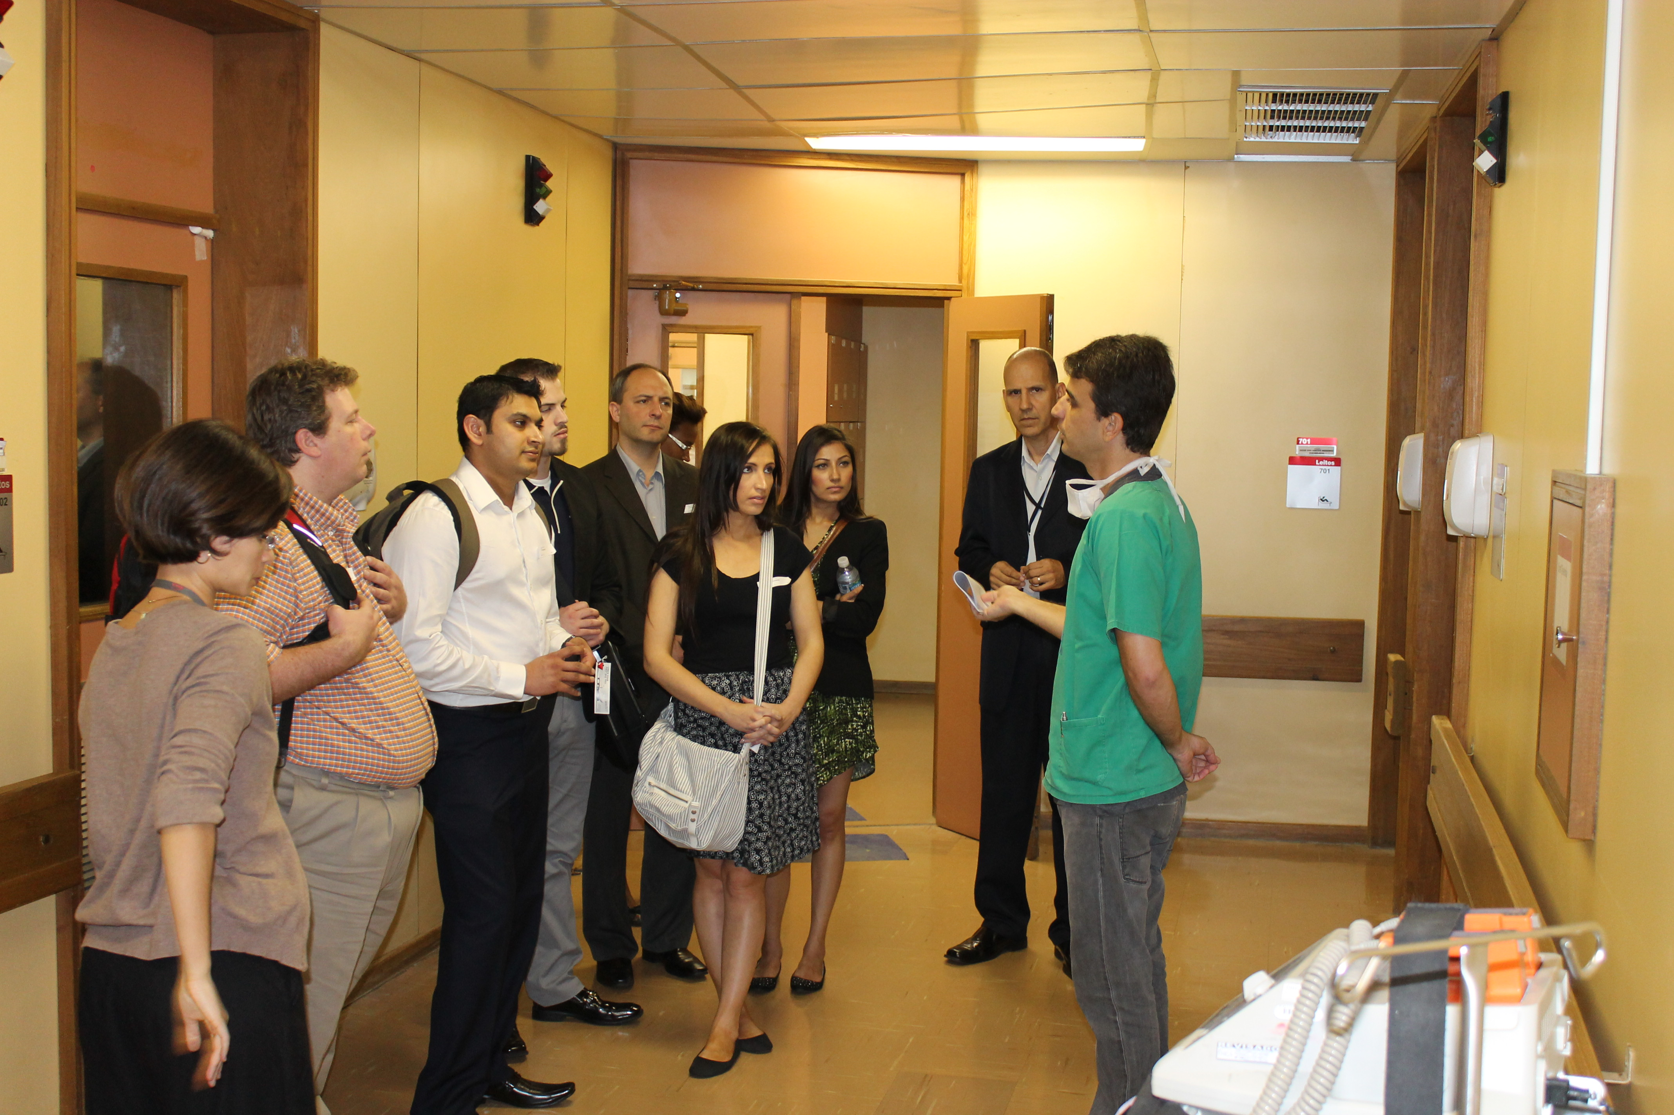
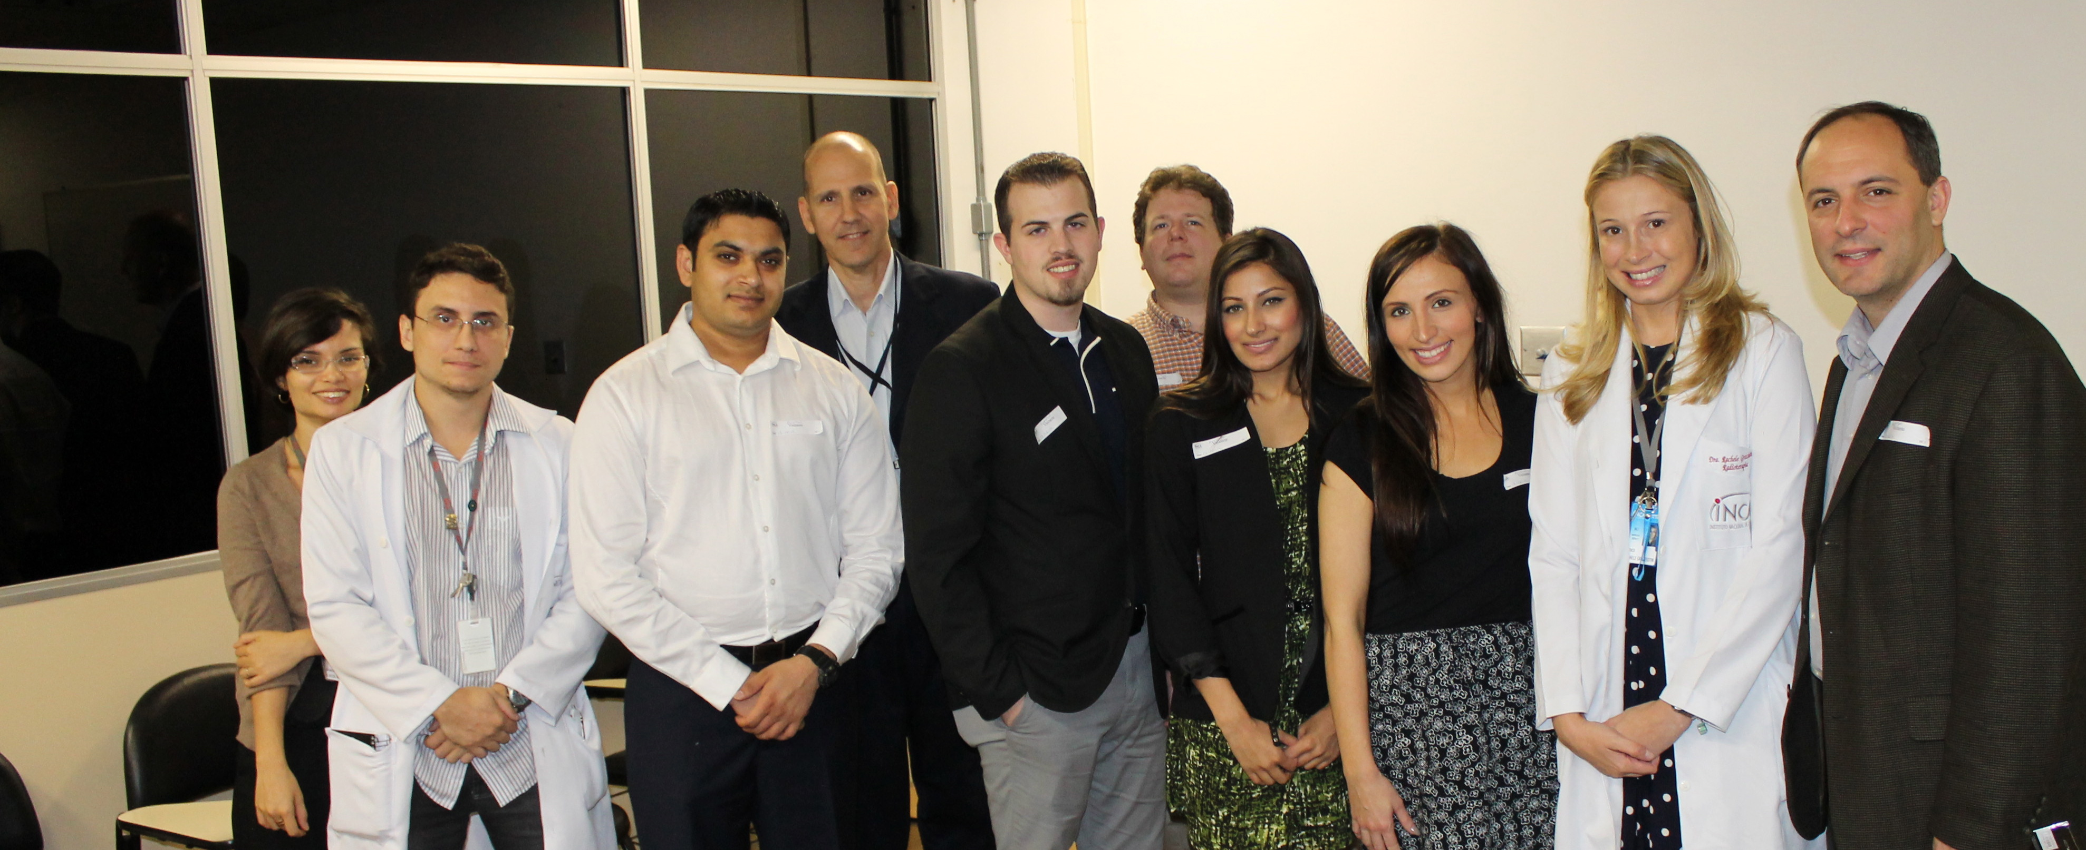
INCA: Transplant Center & Cancer Institute
Tour of the facility
Pediatrics
Bone marrow transplant
Radiotherapy

Slide 4
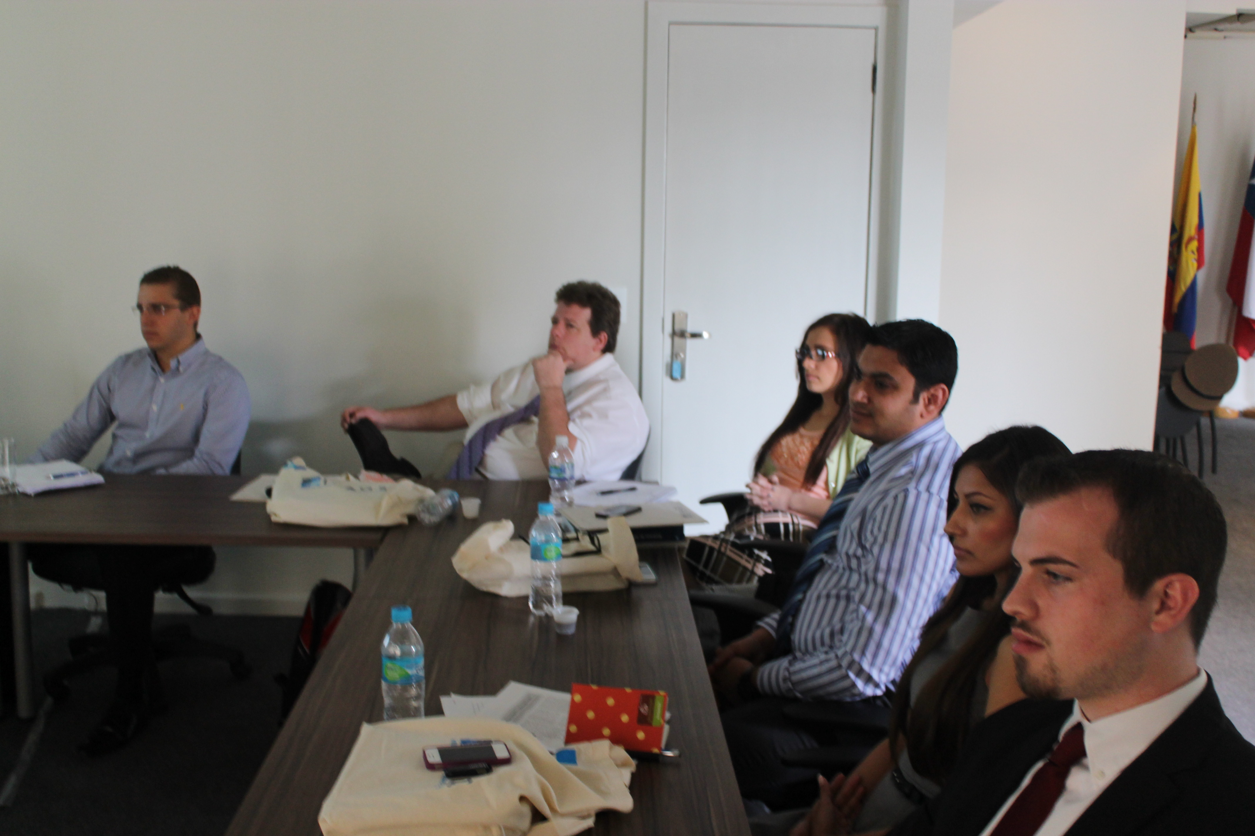
ISAGS: South American Institute of Government & Health
Presentation on the organization

Slide 5
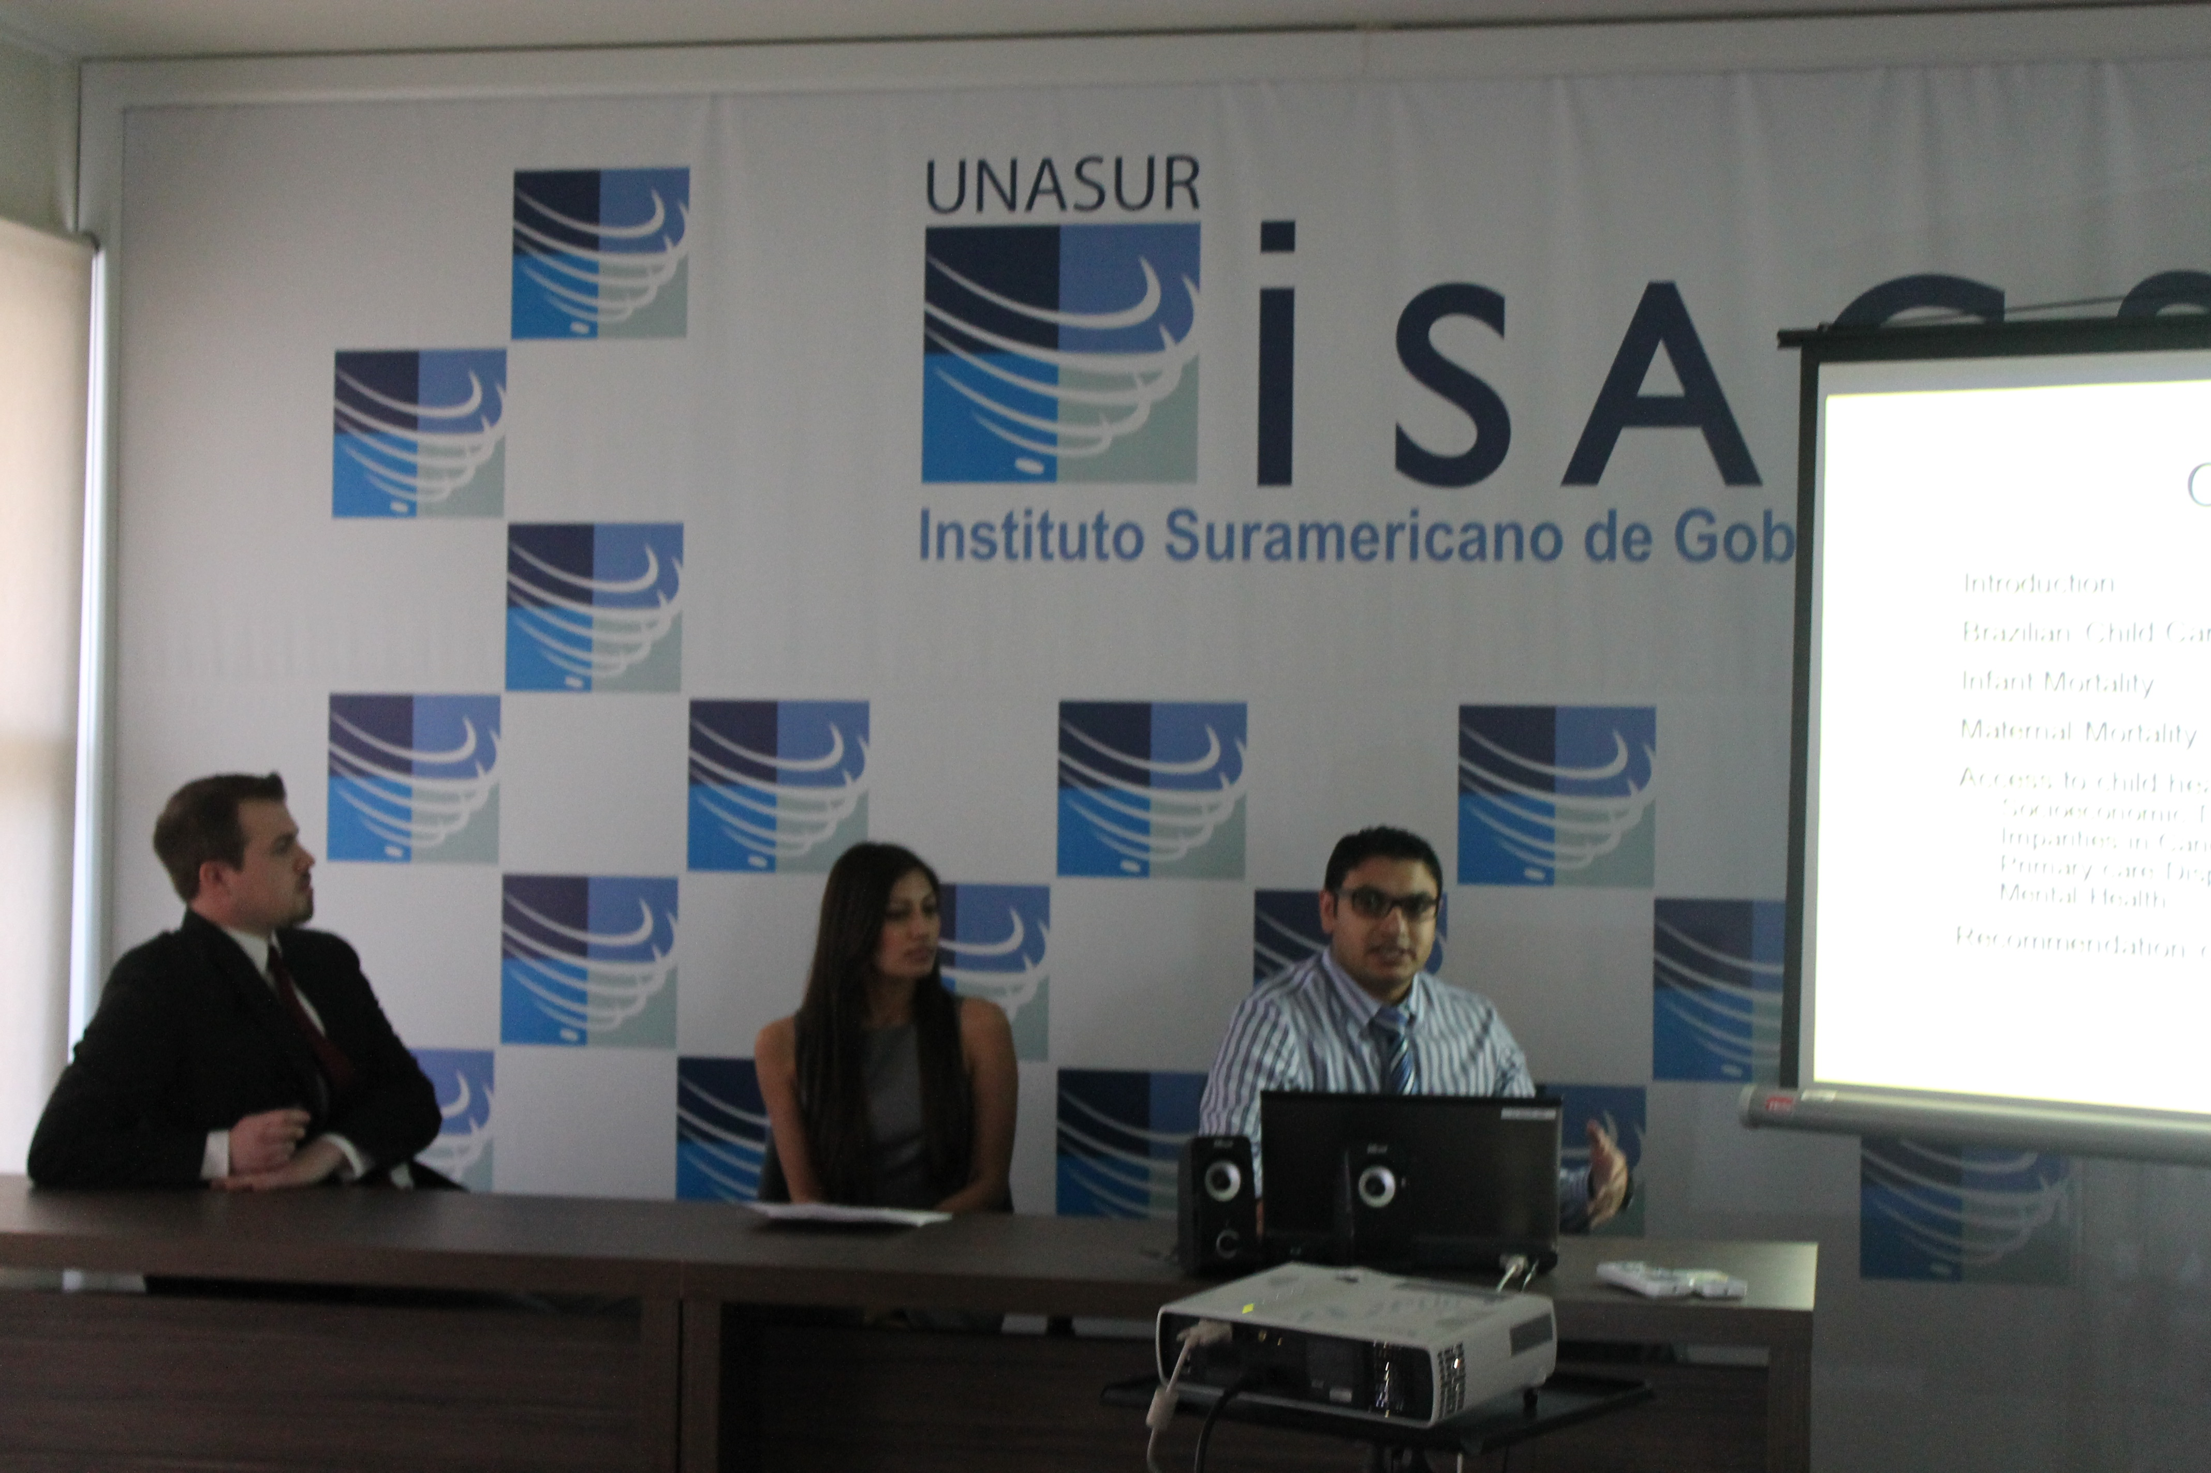
ISAGS: South American Institute of Government & Health
Student presentations

Slide 6
ISAGS: South American Institute of Government & Health

Slide 7
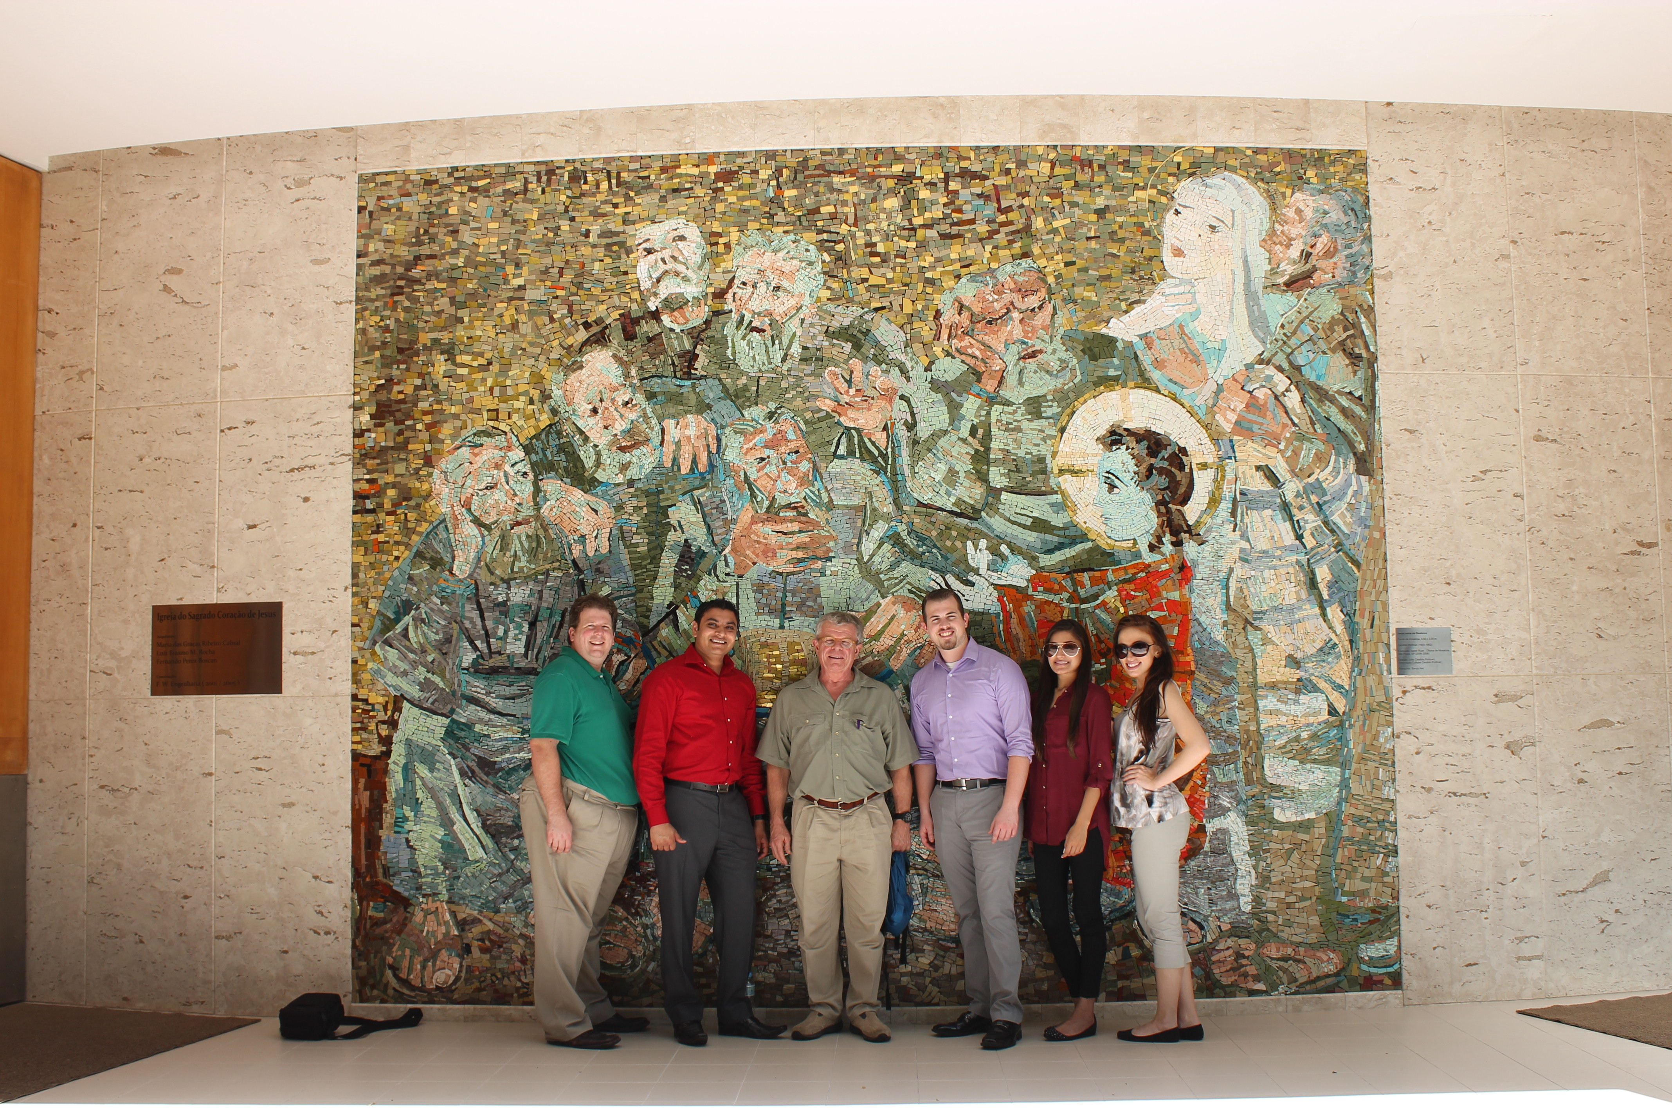
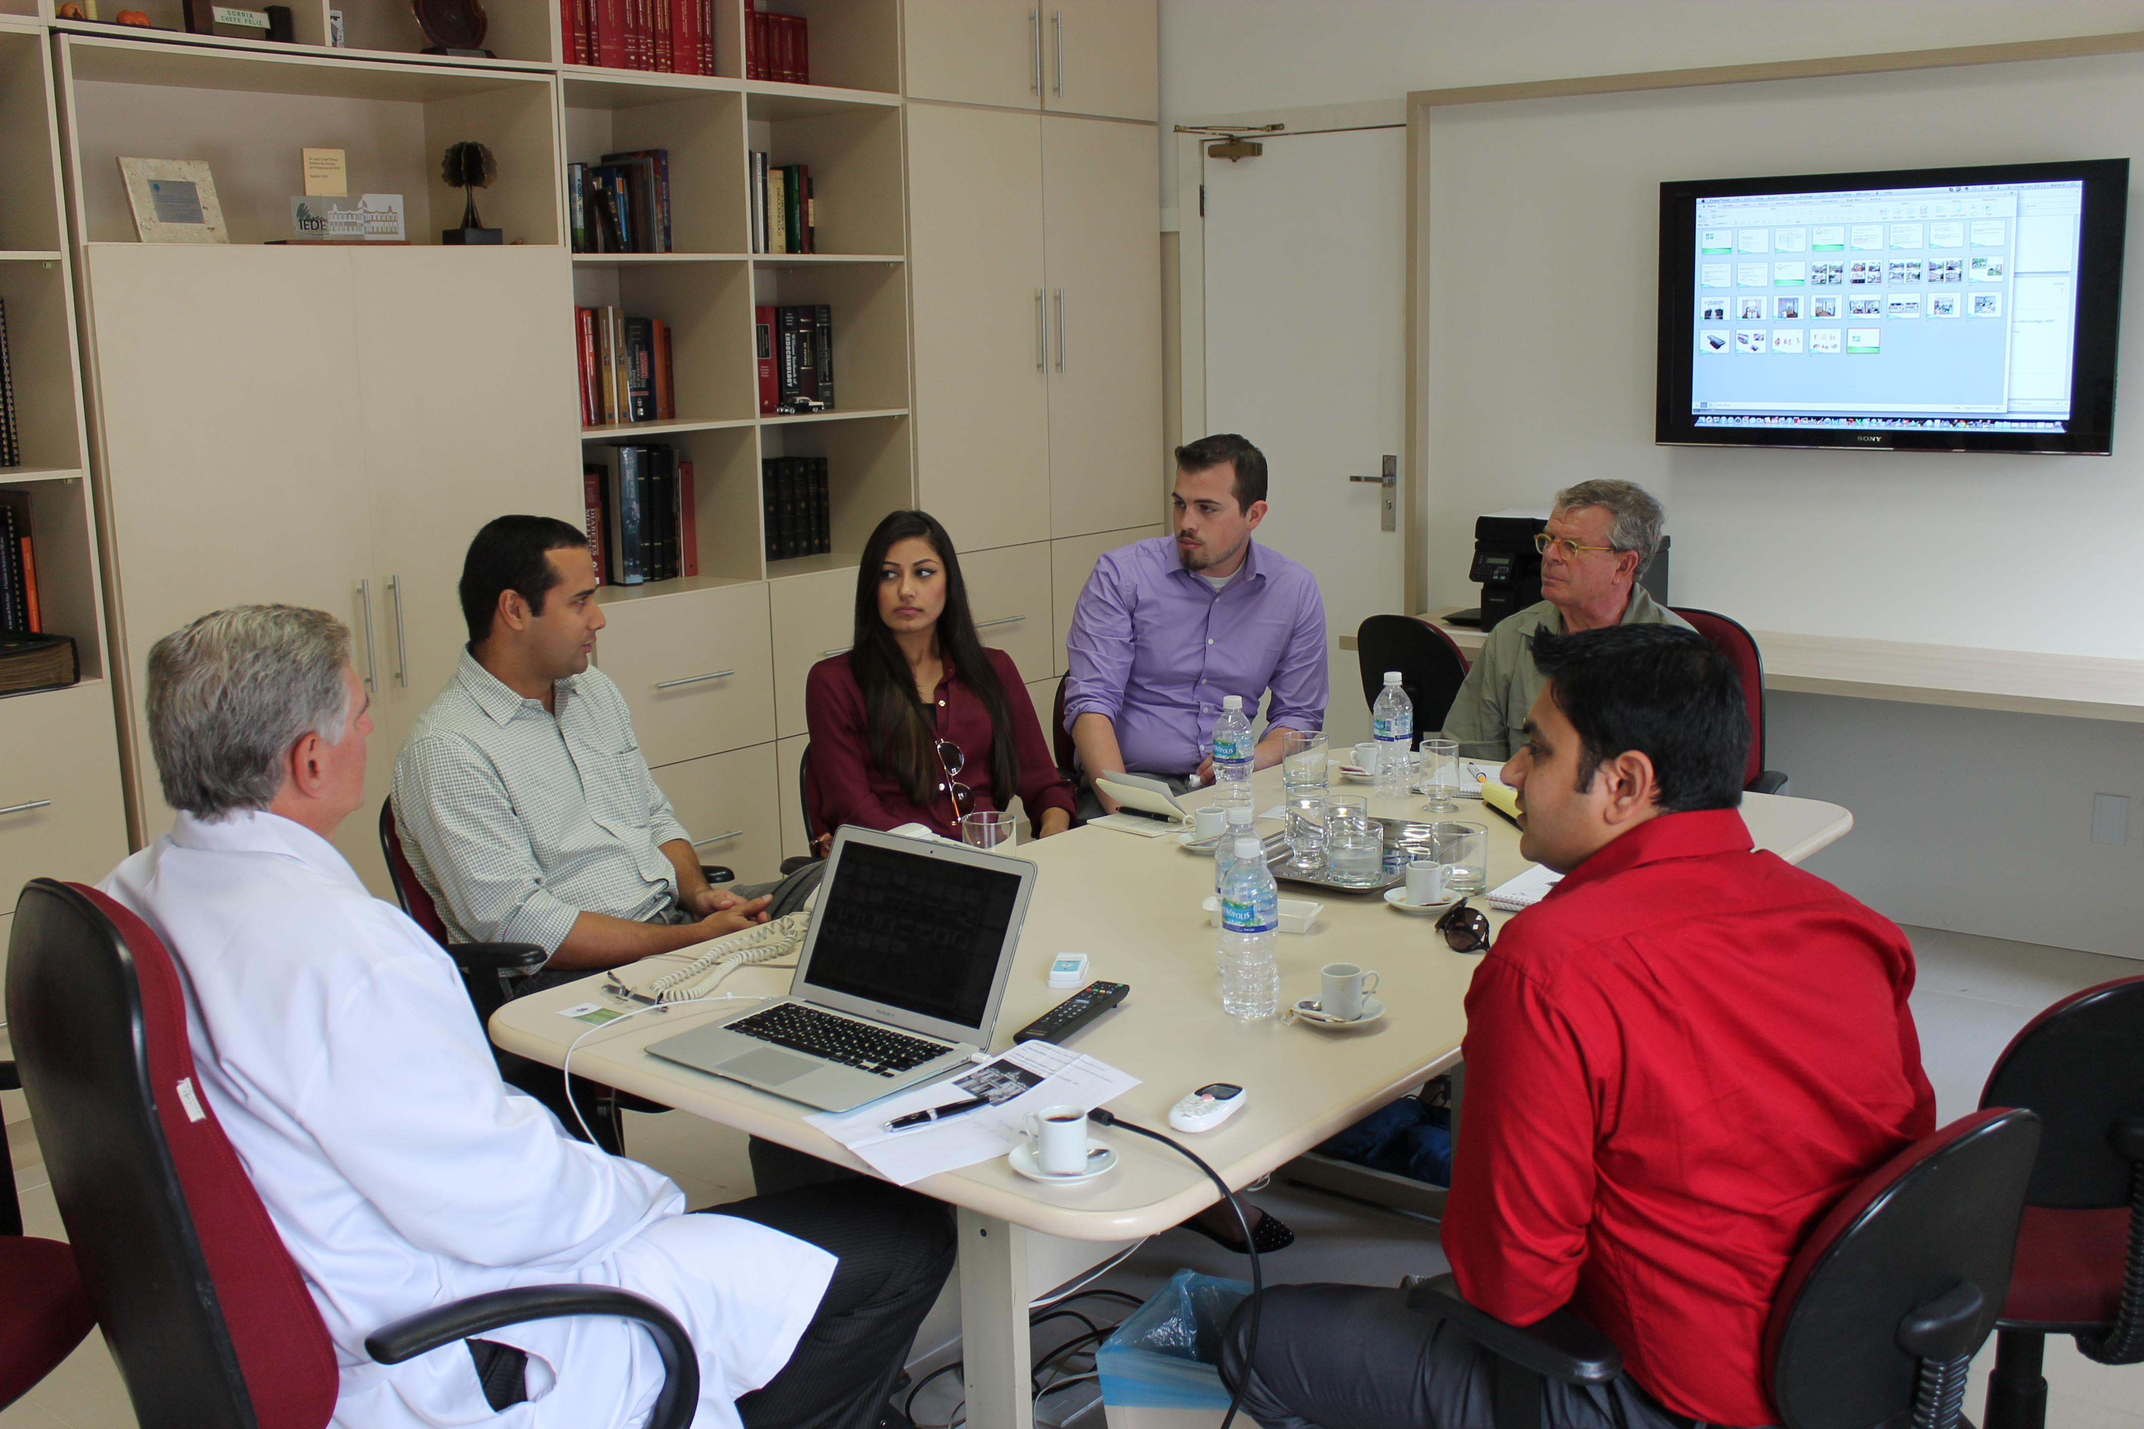
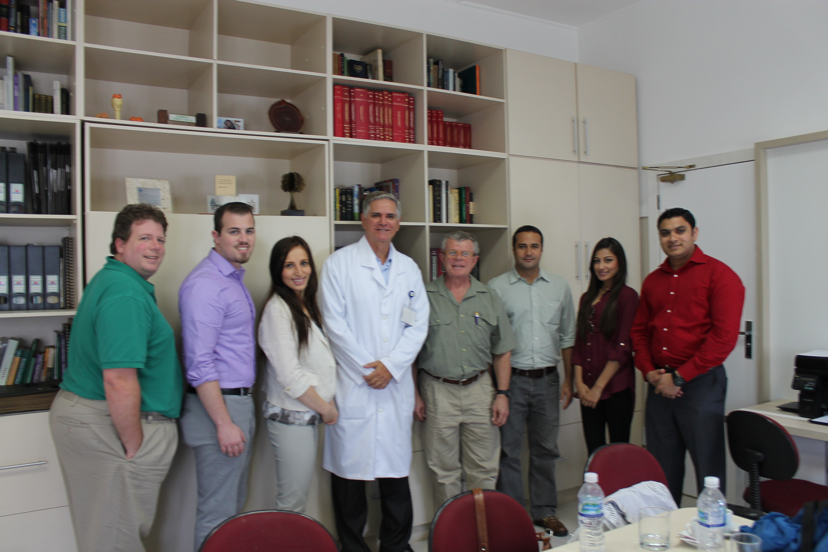
IEDE/PUC-Rio
Discussion with Dr. Coutinho
Campus tour

Slide 8
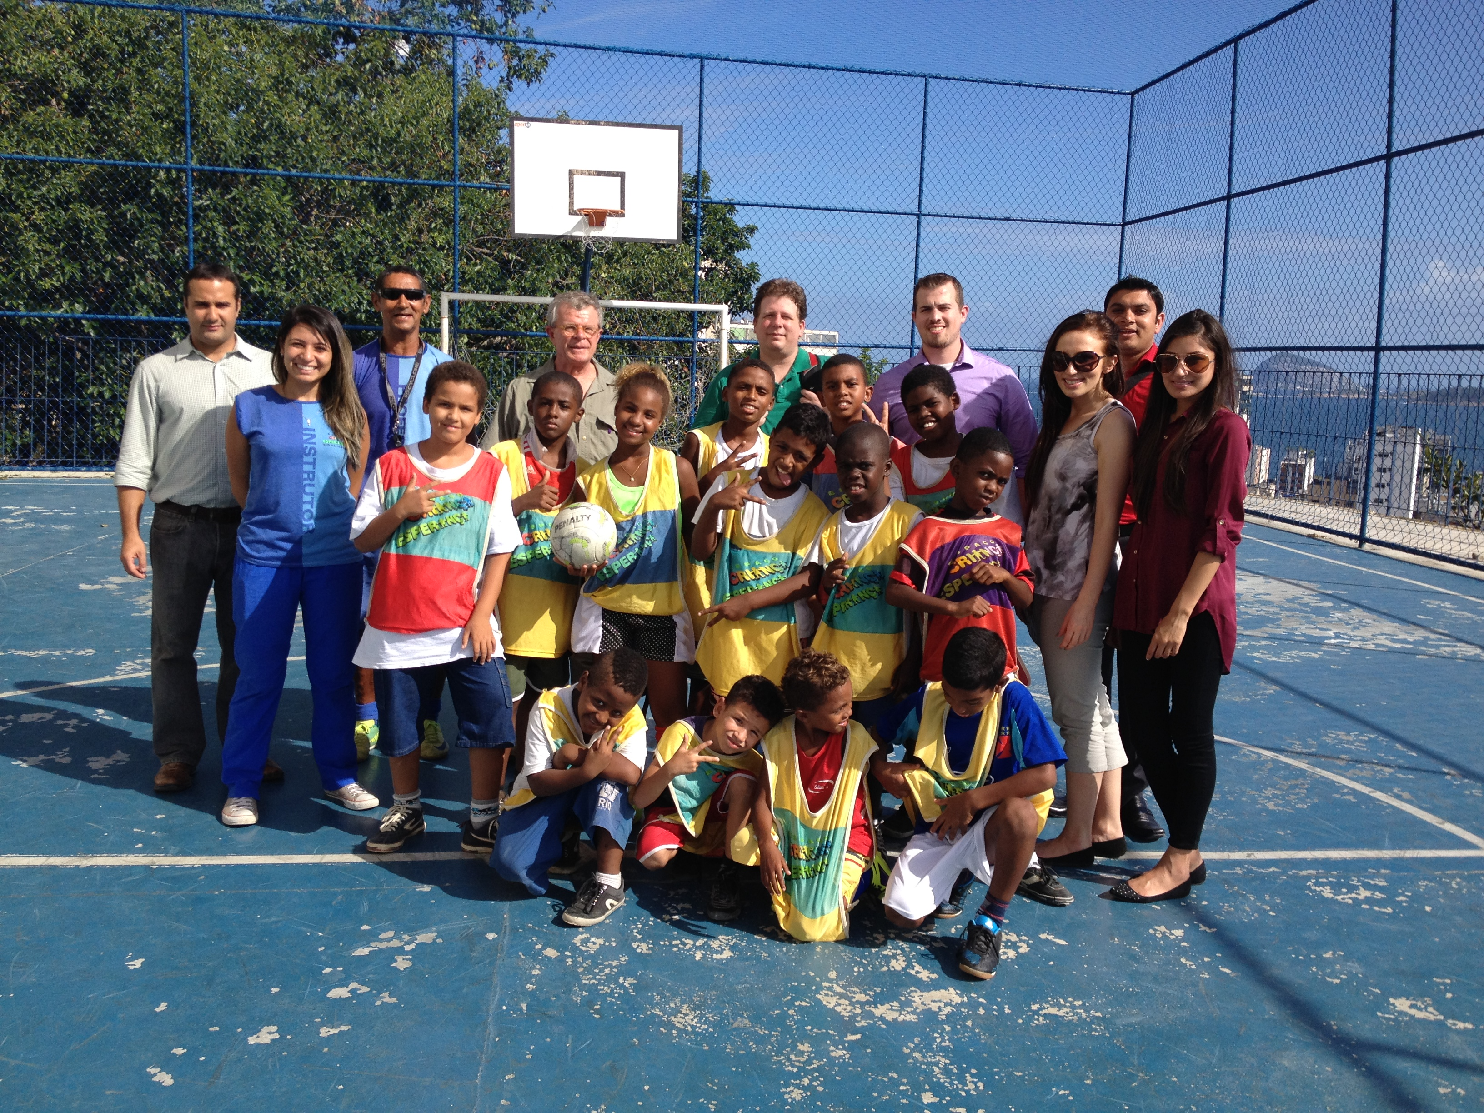
NGO: Hope Child Space of Cantagalo

Slide 9
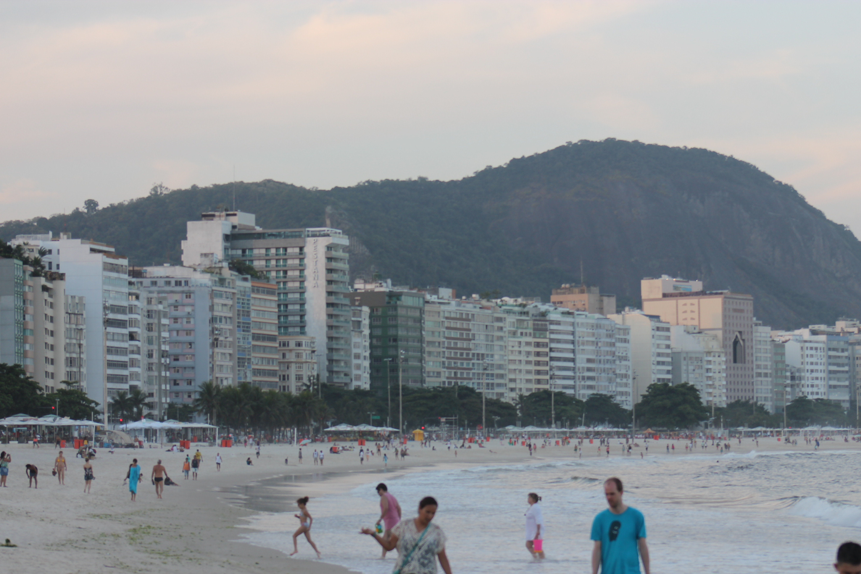
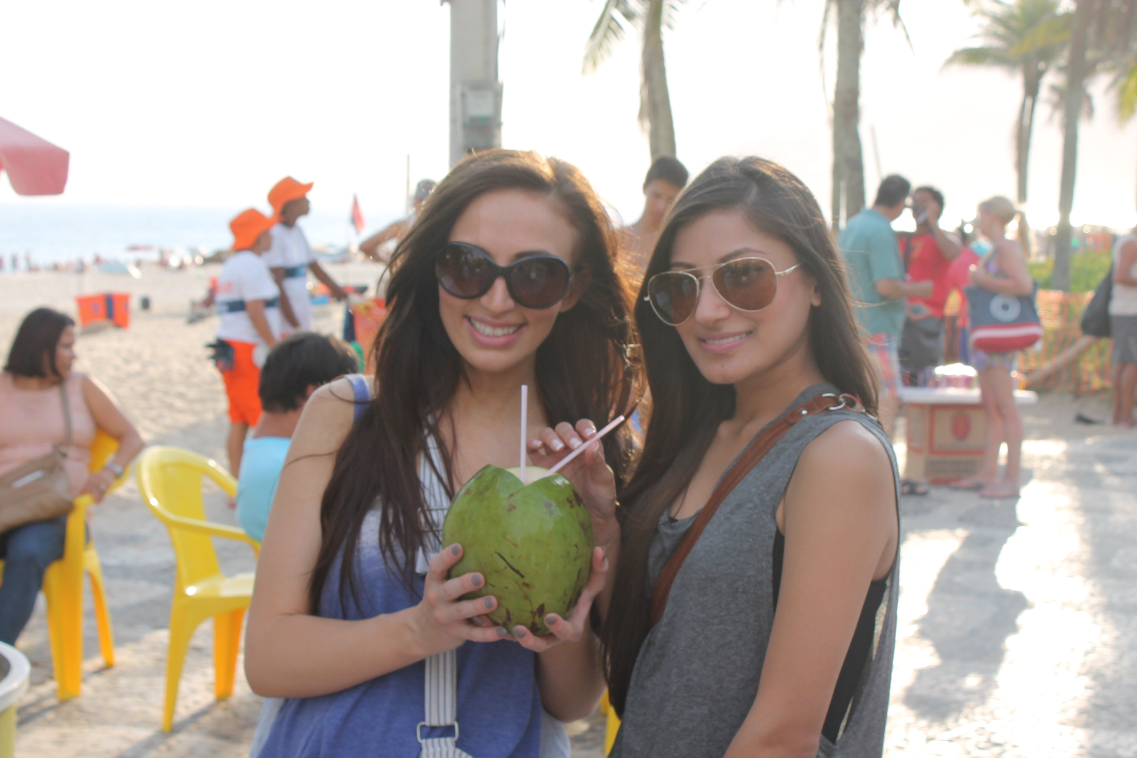
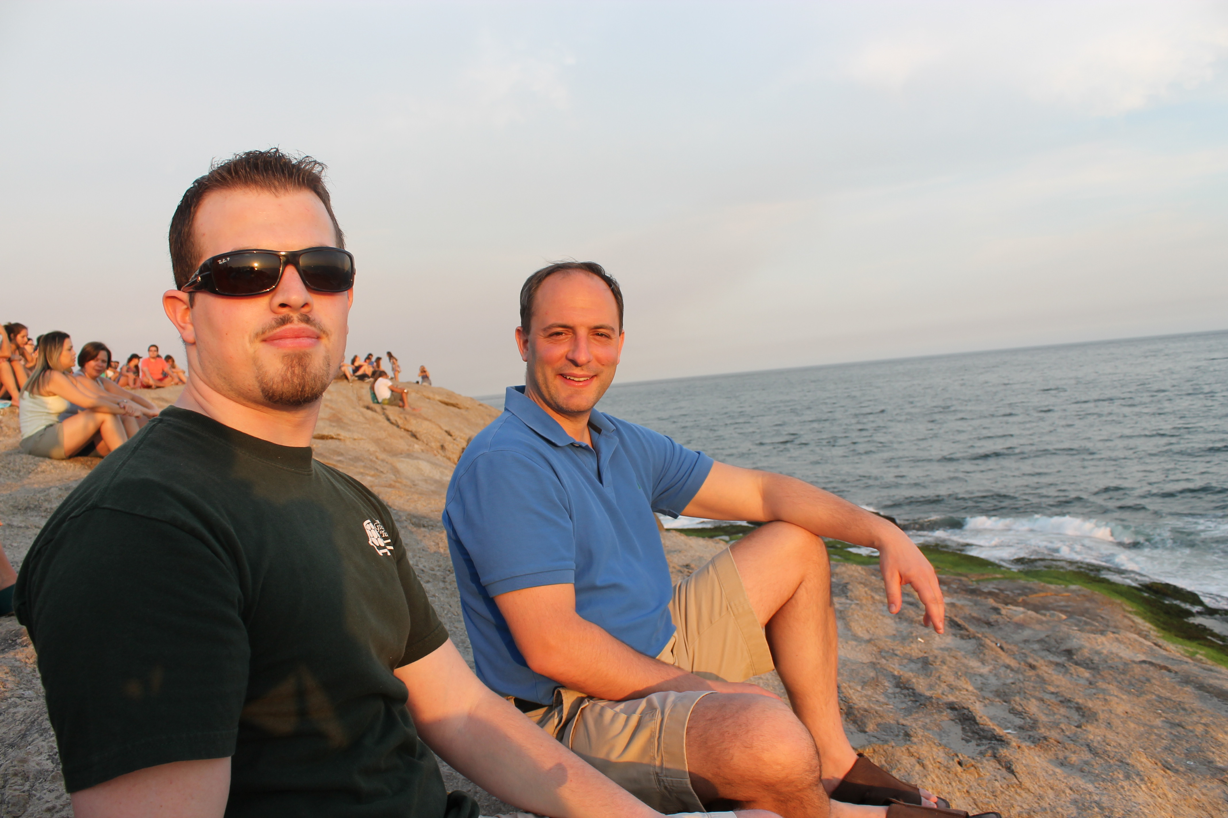
Tourism & Activities
Ipanema & Copacabana Beaches

Slide 10
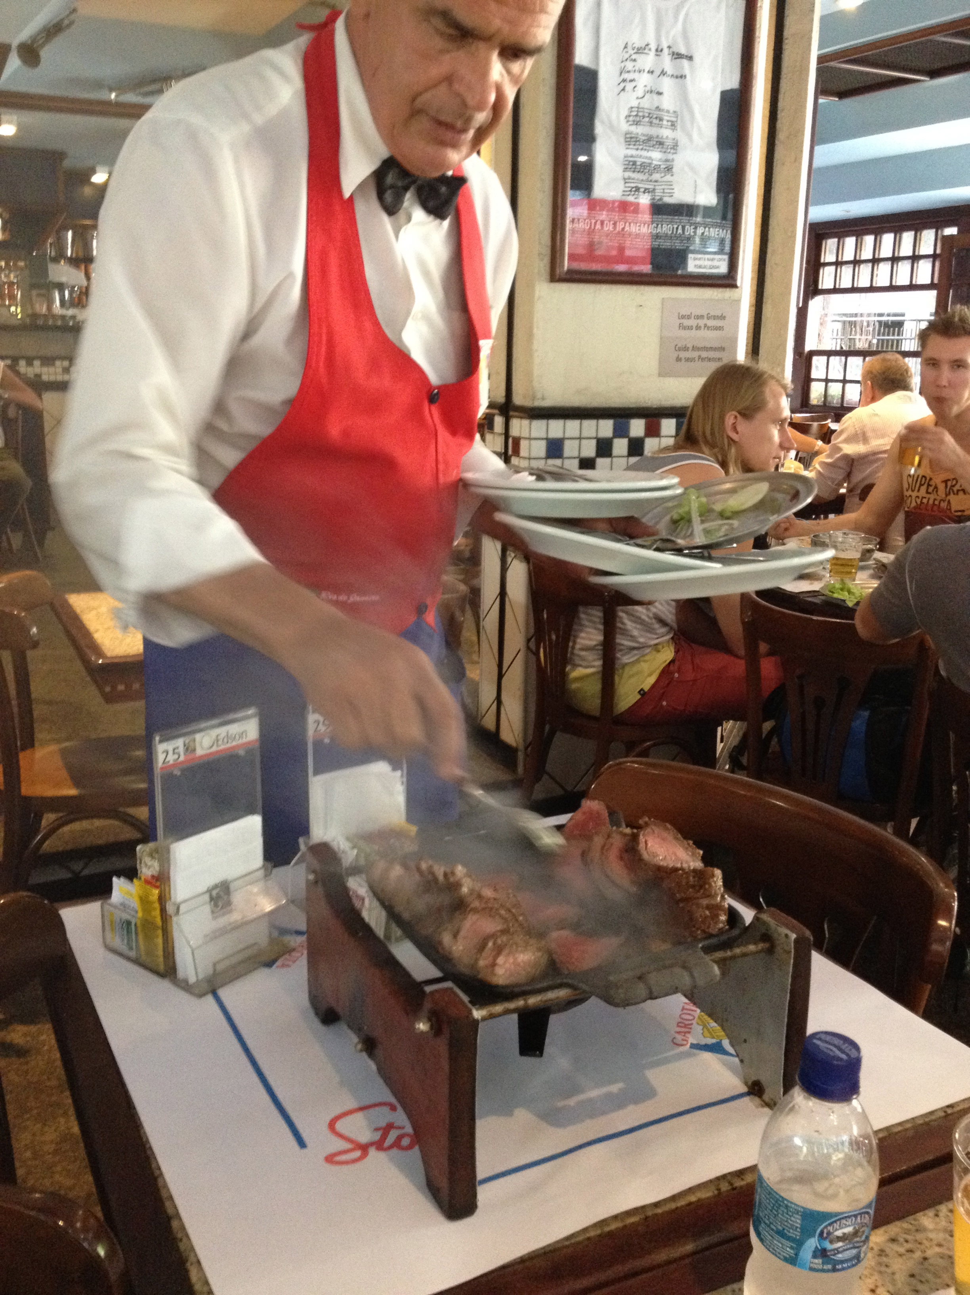
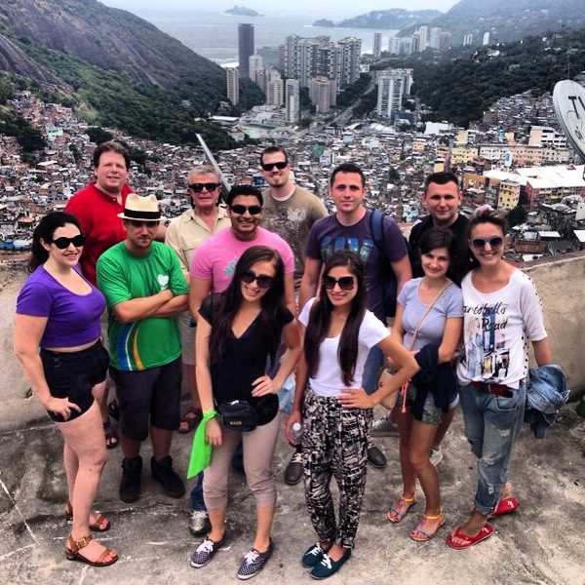
Favela Tour
Good eats

Slide 11
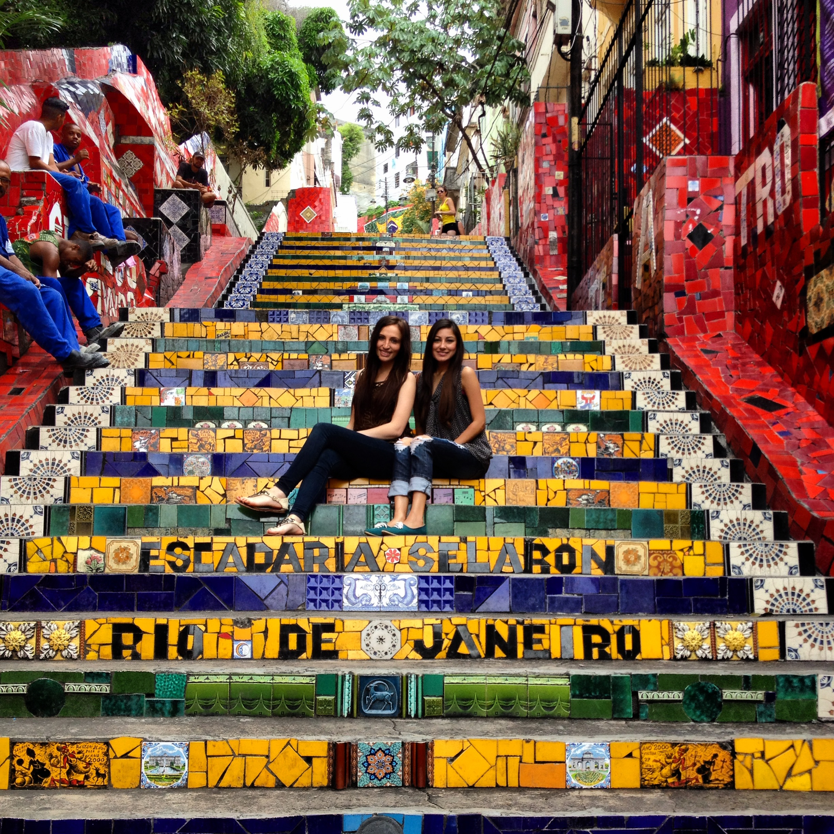
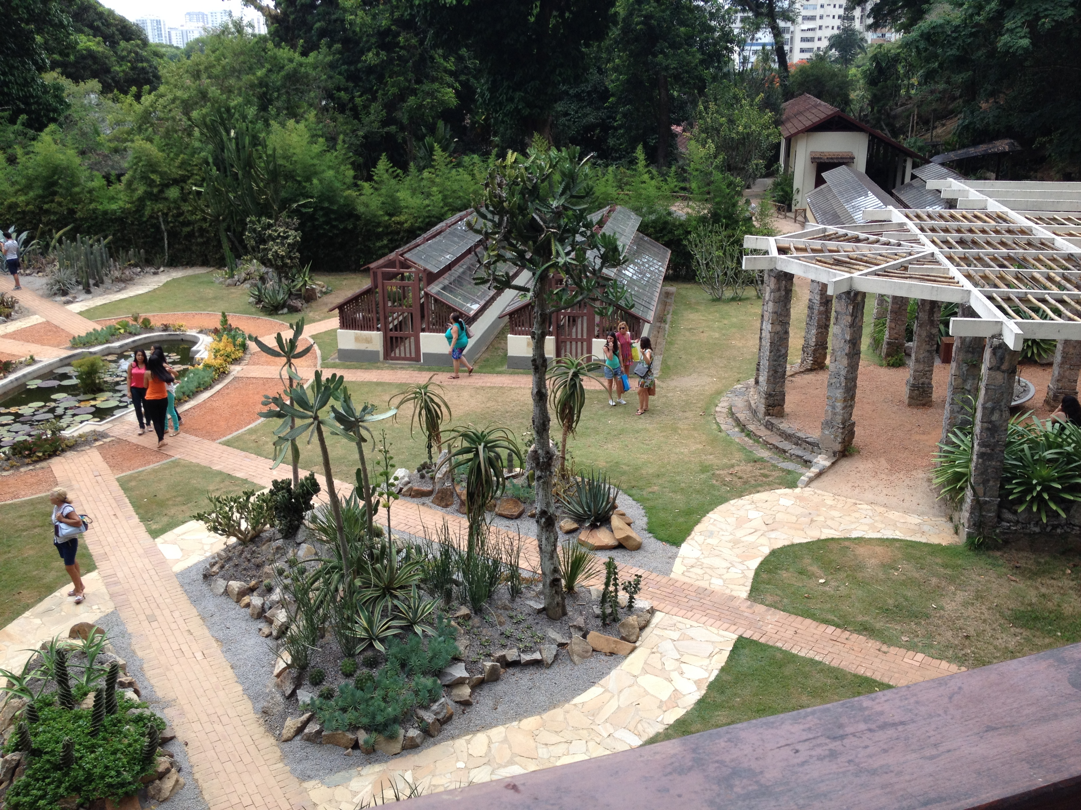
Forte de Copacabana
Escadaria Selaron
Botanical Garden

Slide 12
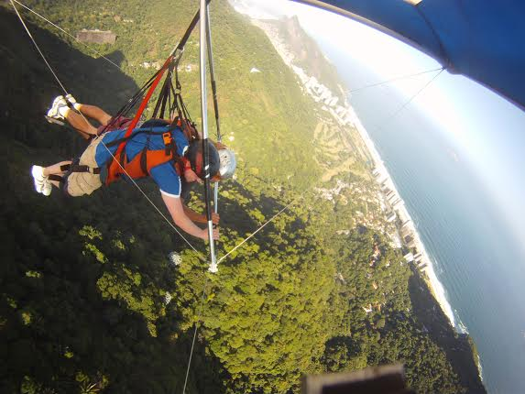
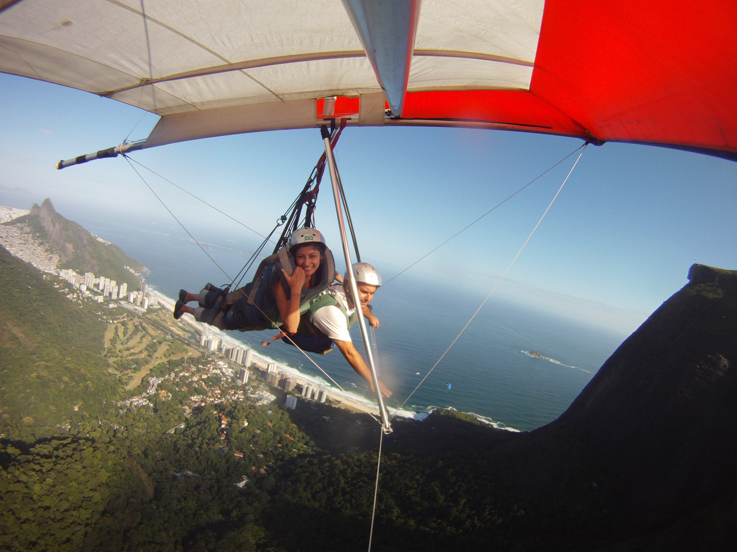
Hang gliding

